Slide 1
HENKEL AG & Co. KGaA QCLAD Workshop Wrap-up
Henkel and Thermo Fisher Team
7 Jun 2024

Slide 2

Workshop Deliverables
Draft version of RTM
Confirmation of the requirement topics discussed during kick off workshop
Agreement on Project Governance by both parties
Project Management Plan (not standard format to be decided later, high-level milestone plan with goals and responsibilities )
Detailed requirement gathering plan
Kickoff deck
Issues (parked items, action items) log
Workshop summary notes
2

Slide 3
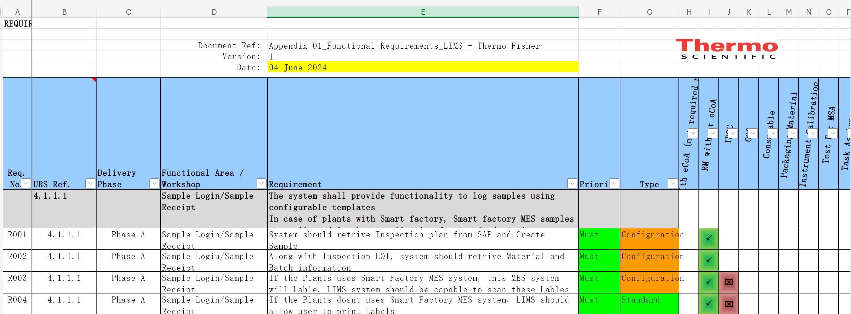
Workshop Deliverables
Draft version of RTM
3

Slide 4
Workshop Deliverables
Confirmation of the requirement topics discussed during kick off workshop
13 workflows finalization - need to get final updated PDF copy
Sampling Scheduler – 7 Jun post lunch
Pilot Phase A: Shift management
Pilot Phase B: Scheduler
Third party application interface - TBD
SAP
Smartfactory (Vegam)
Skillmatrix (OSDP)
4

Slide 5
Workshop Deliverables
Agreement on Project Governance by both parties
Project Management Plan (not standard format to be decided later, high-level milestone plan with goals and responsibilities )
RTM Document approval time - 1 week including all iterations.
RTM will be created module wise
Milestone delivery document review – will be confirmed during milestone review.
PMP document will be a lean document with the reference to SOW and other documents.
Project plan - Separate project plan (.mpp)will be created for Phase A.
Communication plan – refer to SoW
Deliverables – via delivery acceptance form
Milestones – Refer to SoW
Risk log – document at shared location
Issue log – document at shared location
Meeting notes – document at shared location
FRS document - live document - reference document for Hekel technical team and no review is required.
FRS will be created module wise
Configuration summary - live document - for reference for Hekel technical team and no review is required.
Steering committee meeting - follow Henkel template
Monthly milestone review meeting as per the milestone timeline.
Weekly meeting is just for the progress update.
Epic will be created for modules and functions (Design, Test etc.) in Henkel DevOps
Milestone will be created for 1 month in Henkel DevOps
Backlogs will be added to be delivered for each milestone.
5

Slide 6
Workshop Deliverables
Detailed requirement gathering plan
Kickoff deck
6

Slide 7
Workshop Deliverables
Issues (parked items, action items) log
Questions Log
Detailed requirement gathering
Gap Analysis
Project plan with detailed items
Preparation items ready by Henkel
On-boarding Thermo Fisher members
Infrastructure ready such as Dev server, VPN, and remote connection, DevOps etc.
RTM Completion and Sign off
Sign off the FRS 1.0 completion
7

Slide 8
Workshop Deliverables
Workshop summary notes
0.5 day – Kickoff & Project Governance
0.5 day – Lab tour
1.5 day – Training/Demo
1.5 day – Workflow Finalization
1 day – URS topic discussion
8

Slide 9

Workshop Deliverables
Deliverables | Result
Draft version of RTM
Confirmation of the requirement topics discussed during kick off workshop
Agreement on Project Governance by both parties Project Management Plan (not standard format to be decided later, high-level milestone plan with goals and responsibilities )
Detailed requirement gathering plan
Kickoff deck
All workflows reviewed updated and finalized by Henkel
Issues (parked items, action items) log for demo training
Workshop summary notes

Slide 10
10

